Slide 1
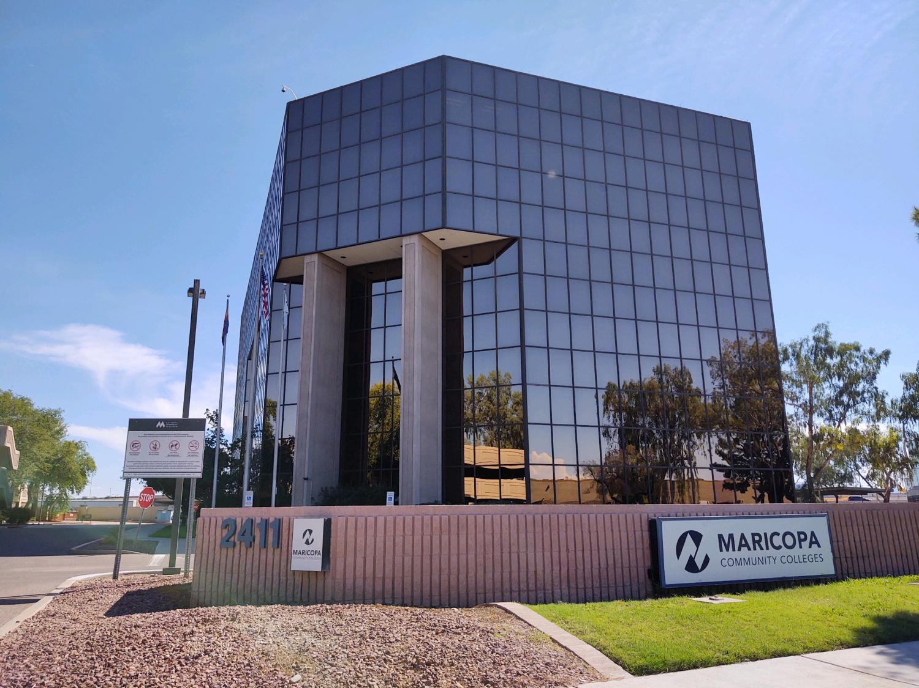
The Community College Key Assignment
CCHE – 580 SEC006

Slide 2


Module 1 – Getting Acquainted with Community Colleges
American community colleges are places that embody communities encompassed with individuals who take a personal interest in assisting students to achieve educational goals.
The Morrill Act of 1862 (the Land Grand Act) provided opportunity for a large majority of individuals (minorities) who had previously been denied access to higher education. In 1901 the first junior college was founded. In 1910 only 3 junior colleges existed in comparison to 14 in 1914. Development of community colleges were influenced by social issues. In 1920 American Association of Community Colleges was founded. Community colleges meet the demands for degree seekers and those interested in vocational programs.
The governance structure within community colleges consists of the Governing Board established in 1996 for the Maricopa Community Colleges. The governing board is comprised of seven seats, two are at-large position which represent the entire county and the other five are elected positions representing geographical districts within Maricopa County. The Chancellor is appointed by the Governing Board (MCCCD) and is guided by the Governing Board and the principles established by the governing board (Maricopa 2023).
The different structures and models consist of leadership which are made up of the College Presidents of the ten colleges under the umbrella of the Maricopa Community Colleges. Community colleges located in counties of Coconino and Pinal are governed by local district governing boards.
The governance model/structure is very different from those found in K-12 educational institutions and universities. The Arizona K-12 public education system is governed by the State Board of Education which are appointed by the Governor of Arizona. The Superintendent of Public Instruction falls under the board and is an elected official. Arizona state universities are governed by the Board of Regents.

Slide 3

Module 2 – What Community Colleges Are All About
Community colleges offer educational programs for members of the community seeking to obtain an associates degree, certificate, vocational training or courses for university transfer or courses geared toward life-long learning. Community colleges are strategic in ensuring that students are successful in completion of academic goals. They offer developmental courses to assist in student retention and achieving their academic pursuits (Cohen, 2008).
Community colleges also offer cultural events highlighting celebrations focused on ethnic groups. A few of the major cultural events celebrated at community colleges ae Black History Month, Pride Month, International Education Week and Hispanic Heritage Month. A large number of community colleges have athletics in a variety of sports, this provides an opportunity for community members to attend games and tournaments. Community members also have access to libraries, fitness centers and other internal/external meeting area used for conferences and meetings. Community colleges also provide support for activities related to economic development, training and business development are common sponsored by community colleges.
Another community engagement activity that community colleges offer are service-learning programs. These programs are incorporated into courses and labs offered at community colleges with the goal of providing opportunities for students to grow skills in leadership, problem-solving and communication. These service-learning opportunities can benefit the communities that community colleges are located in by offering free or reduced priced food boxes containing fresh produce or common food staples such as milk, eggs and potatoes.
Community colleges identify the vision, mission and philosophy of colleges individually based on the goals and objectives that the particular college aspires to reach. These aspirations are identified and agreed upon by college leadership. Community college leadership consist of the College President, Vice-Presidents, Associate-Vice Presidents, Deans and Managers. These leadership positions are filled through the adopted hiring process of the community college. Faculty members are an important part of the community college leadership group and serve as Division Chairs or Department Chairs.

Slide 4
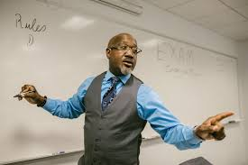
Module 3 – Working in a Community College
Community colleges employ a diverse population ranging from those in leadership positions, faculty, administrative staff and positions responsible for the maintenance and upkeep of the internal and external facilities at the community college.
Faculty positions require certain criteria to be met prior to be considered for a teaching position. Community colleges require a Master’s degree in a specific teaching area along with successful completion of a course focused on teaching and learning outcomes within a community college. A master’s degree is not required for individuals interested in teaching vocational instruction but it is required to successfully complete the three-credit course on teaching and learning in the community college. If you are fortunate enough to find a position you are interested in and qualify it is important to learn about the community college you are interested in serving. You will also want to follow the requirements when submitting your application, if a letter of interest is required be sure to include one. When you get the call inviting you to interview be sure to ask pertinent questions such as if you will be required to offer a presentation, will you be interviewing with a committee and if there is a specific dress attire for the interview.
There are many opportunities available to employees and their families. Maricopa Community Colleges offers tuition waivers for employees and their family members (spouses, children under the age of 24). They also offer screenings that are on-site at community colleges focused on preventing and detecting prostate and breast cancer. Community colleges consistently offer developmental opportunities and access to professional associations.
A greater awareness toward diversity and inclusion has been addressed in a large number of community colleges. Data shows that an increase of female community college presidents has been seen within the last decade of the twentieth century (Phillippe, 2023). If you accomplish to obtain a position with a community college, seek opportunities of engagement and areas where your expertise can serve the community college. Being a member of an educational institution has priceless benefits, be sure to make the most of your experience.

Slide 5

Module 4 – Funding the Community Colleges
Community colleges receive funding from multiple sources, property taxes, state aid, tuition and fees along with a minimal amount from a fund balance and miscellaneous sources. These funding sources have historically provided the majority of funding demands (Ullrich & Norris, 2024). Federal funding comes in the form of grant money and financial aid and specific community colleges receive additional funding for certain designations. Community colleges recognized as Hispanic serving institutions receive additional funding in the form of grants, other qualifying programs can increase grant funding.
State’s pay community colleges based on full-time student equivalent, using a specific calculation to determine the amount paid. This is determined by the number of credit hours designated toward those students identified as full-time students. The quantity of full-time student equivalent (FTSE) enrolled within 45 days after classes commence in the fall semester to the amount of FTSE enrollment within 45 days after classes commence in the Spring semester (short-term courses are not included) then divided by 2 is how this is calculated.
There is a large disparity in the amount received in state funding between community colleges and four-year institutions. This has caused community colleges to be creative in identifying funding sources creating partnerships with businesses, asking for donations from alumni and private donors. Maricopa Community College is facing challenging times which may impact their budget placing the college in a fragile state. The Maricopa Community Colleges is being affected by a class action lawsuit (Qasimyar v Maricopa County) in where the county of Maricopa incorrectly classified some homes for tax purposes which resulted in errors. This resulted in a refund of approximately 45 million from Maricopa Community Colleges. The amount is substantial because 75 percent of the budget derives from property taxes.

Slide 6

Module 5 – Teaching and Learning in the Community Colleges
Maricopa Community College are nationally accredited by the Higher Learning Commission. Founded in 1895, the Higher Learning Commission (HLC) as an independent agency serves as an institutional accreditor to degree issuing colleges and universities (Higher Learning Commission, 2024).
The purpose of accreditation for Maricopa Community Colleges is to ensure that the institution is meeting quality standards while providing students with education of high-quality. In their achievement of accreditation, the college makes certain that the highest level of learning standards is met with integrity and quality. Maricopa Community College district oversees ten colleges which receive accreditation independently. The college recently received accreditation approval from the Higher Learning Commission to offer a limited number of bachelor’s degrees.
There are more than a hundred programs offered at community colleges, traditional programs and those required to meet the demand of current careers and employment opportunities. There are internal and external factors influencing curriculum at community colleges, these range from demographics, resources, regulations industry demands just to name a few. Career counseling is just one resource available to students who help identify careers they are best suited based on varying factors. Students can also obtain the cost of a program by utilizing tools available such as the tuition calculator. Community colleges have made obtaining a college degree more attainable by partnerships with state universities and by establishing a partnership with companies who provide financial support to employees interested in obtaining education and advancement in skills to grow and empower their abilities resulting in a stronger workforce.

Slide 7

Module 6 – Planning for the Future of Community Colleges
Community colleges have served as vital elements to the American educational system making higher education accessible to millions of students worldwide. The ever-changing world we are experiencing today requires community colleges to examine ways to transform to meet the demands that exist. The challenges community colleges are facing today are enrollment, retention and technology which have a direct impact on the financial health of community colleges.
Community colleges have proven to be adaptable, responding quickly to change. They have demonstrated effectiveness in being teaching institutions of quality demonstrating high academic standards (Loveless, 2023). The confidence that industries and businesses have in community colleges to meet the needs of todays workforce is impressive. Responding to todays demands for careers in advanced technology by making available simulated work environments is just one of the ways that community colleges are responding.
The most critical issue that has persisted with community colleges is funding. They need stable funding to respond to current demands and those yet to come. Having the ability to provide education and training for emerging technologies is a responsibility with prioritization for community colleges. Providing a culture of innovation must be demonstrated in programs, curriculum, digital technologies, faculty development and learning modalities with community colleges today. Education is a priceless gift, community colleges provide this priceless gift to everyone, they need support to make to continue to make this available to all.

Slide 8
References
Maricopa Community Colleges. (2023). Maricopa Governance; MCCCD Board Policies and Administrative Regulations.
https://district.maricopa.edu/governance
Cohen & Brawer.. (2008). The American Community College 95th Ed). San Francisco; Josey-Bass.
Phillippe, K. (2023). Community College Daily; DataPoints: Women CEOs at Community Colleges.
ccdaily.com/2023/03/datapoints-women-ceos-at-community-colleges/
Ullrich & Norris. (2024). EdNC; Following the money: State and local funding for community colleges in the Fifth District of the
Federal Reserve. https://www.ednc.org/research-following-the-money-state-and-local-funding-for-the-community-colleges-in-the-fifth- district-of-the-federal-reserve/
Higher Learning Commission. (2024). About HLC. https://www.hlcommission.org/about-hlc/
Loveless, B. (2023). Community Colleges vs Universities. https://www.educationalcorner.com/community-colleges-vs-universities/

